Slide 1


DIT/11/C2/0328
DIT/11/C2/0343
DIT/11/C2/0345
DIT/11/C2/0353
DIT/11/C2/0357
Kirinda G L M
Piumika W M S
Jayarathne R P E T
Thilantha B Y
Chathuranga A W I
Topic : video rental system
__________________
ER Diagram
Queries
Interface
Advantages

Slide 2

QuerNHHUBUBies
GROUP BY
JOIN
NESTED
SELECT
Back

Slide 3

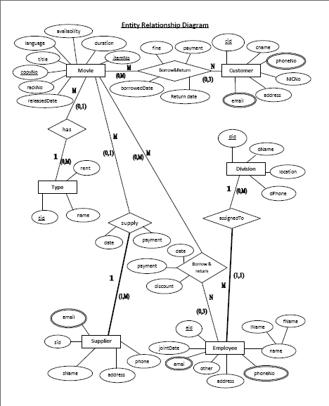
ER Diagram
Back

Slide 4
Queries
GROUP BY
JOIN
NESTED
SELECT
Back

Slide 5

GROUP BY
Number of Phone Numbers that each Custemaer has
SELECT Customer, COUNT(phoneNo) Phone_Numbers
FROM Customer_Phone_NoC2207
GROUP BY Customer;
Number of Employees in each Division
SELECT Division, COUNT(eid) Employees
FROM EmployeeC2207
GROUP BY Division;
Total payments for each Supplier
select supplier, SUM(sup_payment) Total_Payment
from Movie_CopyC2207
group by supplier;
Back

Slide 6
JOIN
Customer Details with Phone Numbers
SELECT c.fname,c.lname,c.address,cp.phoneNo
FROM CustomerC2207 c,Customer_Phone_NoC2207 cp
WHERE c.cid=cp.customer;
Suppliers' Phone numbers
SELECT sid, name, phoneNo
FROM SupplierC2207 s,Supplier_Phone_NoC2207 sp
WHERE s.sid=sp.Supplier;
Employees with their Division Details
SELECT e.eid,e.fname,e.lname,d.name,d.location,d.phoneNo
FROM EmployeeC2207 e,DivisionC2207 d
WHERE e.Division =d.did;
Back

Slide 7
NESTED
  Find Registered customers who have not returned Videos on time
  select cid, NICNo, fname, lname
  from CustomerC2207
  where cid in ( select customer
  from C_Borrow_and_ReturnC2207
  where DATEDIFF(DAY, borrowedDate, CONVERT(date, GETDATE())) > 7 and
  returnDate is null);
  Find Employees who have borrowed videos
  select eid, NICNo, fname, lname, Division
  from EmployeeC2207
  where eid in ( select Employee
  from E_Borrow_and_ReturnC2207)
Back

Slide 8
SELECT
select *
from C_Borrow_and_ReturnC2207
where DATEDIFF(DAY, borrowedDate, CONVERT(date, GETDATE())) > 7 and
returnDate is null;
select relesed_date, title, duration, language, rackNo
from Movie_ItemC2207
order by relesed_date desc;
select itemNo, copyNo
from Movie_CopyC2207
where DATEDIFF(DAY, sup_date, CONVERT(date, GETDATE())) > 120;
Back

Slide 9
Advantages
Will be quick & easy to search for Details
Data can be edited easily
Can maintain very large amount of data
No more time wasting
Can increase their efficiency
They can buildup their business better & faster
Back

Slide 10
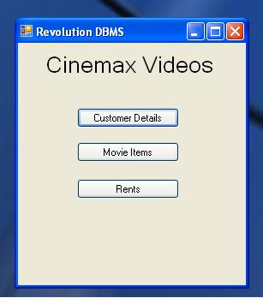
Interface
Back

Slide 11

. . . THANK YOU . . .
………….

